Slide 1
Deep Learning Course
Training

Slide 2
Reminder: Network Architecture
Input Layer
Hidden Layers
Output Layer
.
.
.
.
.
.
.
.
.
.
.
.
.
.
.
.
.
.
.
.
.
.
.
.

Slide 3
Logits and Activation Functions
Input Layer
Hidden Layer
Output Layer
z
a
Activation Function
Logit
X
Y₀
X
Y₁
X
Y₂

Slide 4
Backpropagation

Slide 5
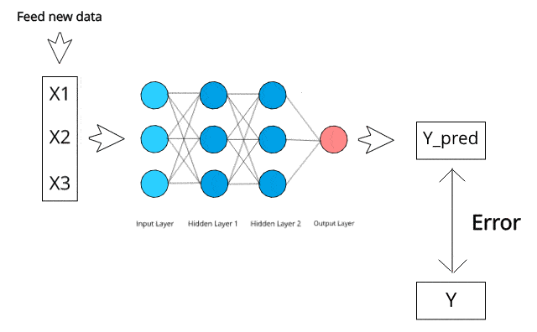
From Inputs to Loss

Slide 6
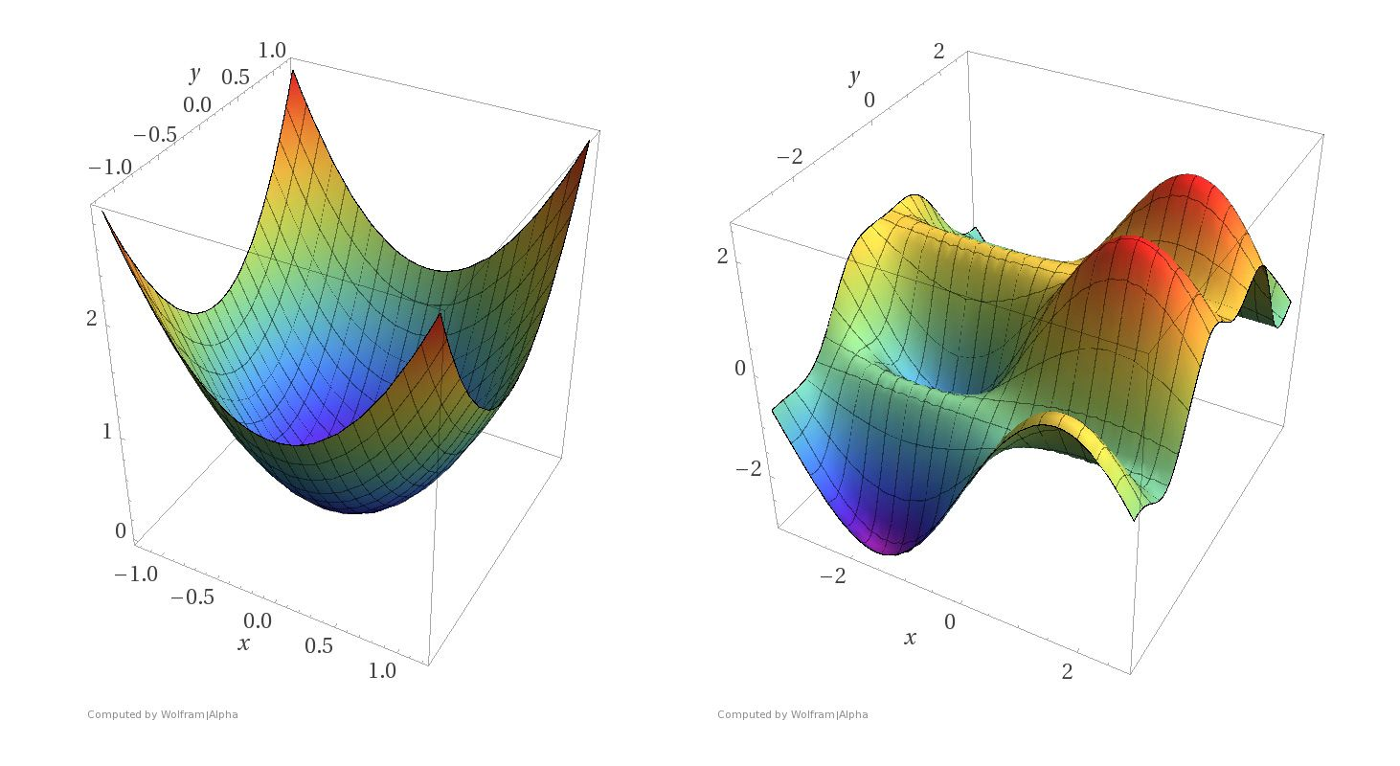
Learning the Parameters aka Training the Network
https://blog.paperspace.com/intro-to-optimization-in-deep-learning-gradient-descent/
We cannot directly use optimisation as for Linear Regression and Logistic Regression
Instead we use optimisation alongside another algorithm that distributes the weight changes that are necessary
This is the backpropagation algorithm

Slide 7
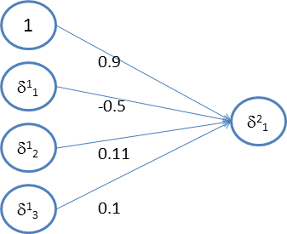




Backpropagation
Error Derivatives
Idea 1: The recursive error derivative

Slide 8

Backpropagation
Idea 2: Output Layer Error Derivative

Slide 9



Backpropagation
Idea 3: Weight Changes

Slide 10
Backprop Overview
Input Layer
Hidden Layers
Output Layer
.
.
.
.
.
.
.
.
.
.
.
.
.
.
.
.
.
.
.
.
.
.
.
.
Calculate Error Derivative (not error) for final layer
Calculate Error Derivative for prior layer - proportional to derivative in final layer, weights, and activation in prior layer
Calculate weight updates to be made.

Slide 11
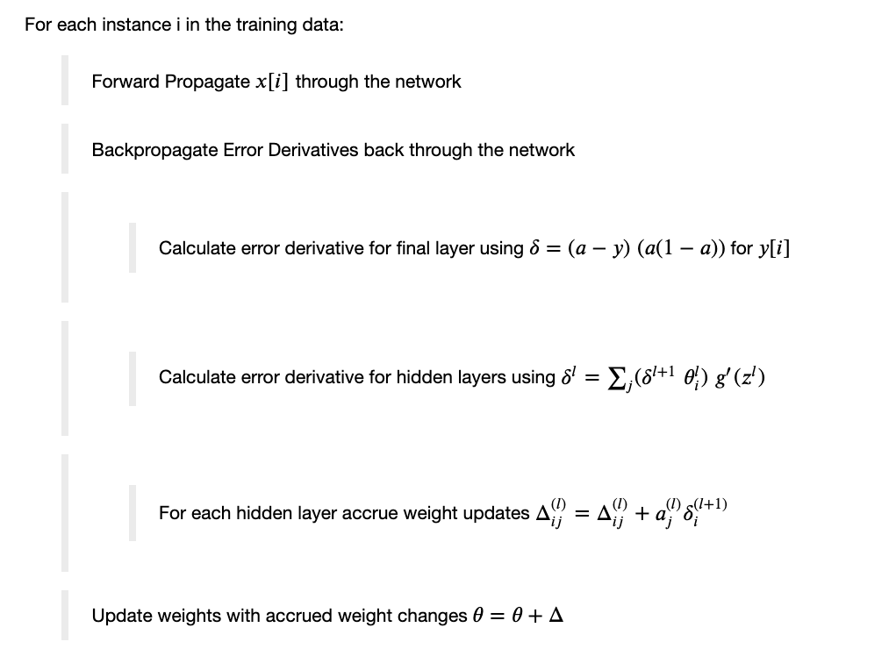



Backpropagation Algorithm

Slide 12
https://www.google.com/search?q=backpropagation&tbm=isch&tbs=itp%3Aanimated&hl=en&ved=0CAMQpwVqFwoTCIDx0LXVsOcCFQAAAAAdAAAAABAC&biw=1213&bih=608#imgrc=CufDRhQcARzdoM

Slide 13
Do I need to know the derivations?
In short, no. However you should have an understanding of the terminology and ideas as presented in these slides. The derivations in the full notes will help you to understand the ideas at a much greater level of detail and clarity.

Slide 14
Backprop Assignment
Split into small groups and discuss the following while keeping notes on the answers (20 mins):
What is the relationship between Gradient Descent and Backprop?
Do we need to calculate error for the backprop algorithm?
What impact does backprop have on the input layer?
What does it mean if a weight after training has a value close to 0 (relatively speaking)?
Discuss the interaction between the backprop algorithm and network baiases.
Enter group agreed notes into the form provided?

Slide 15
Losses for Neural Networks

Slide 16
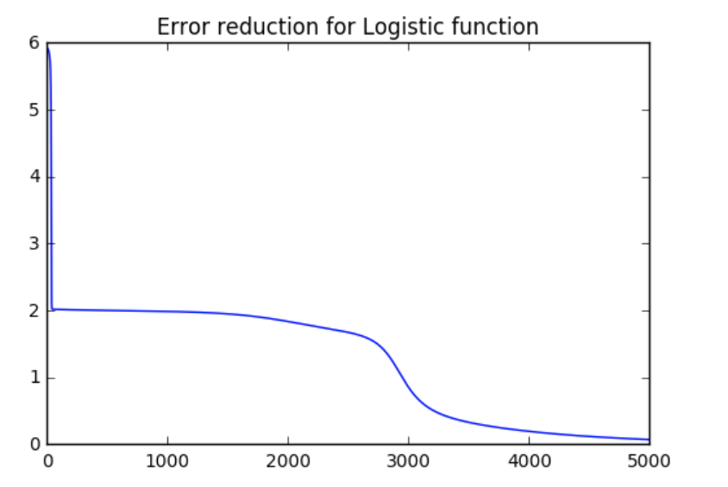
Network Architecture
Input Layer
Hidden Layers
Output Layer
.
.
.
Our goal is to improve on what is already a pretty good machine learning solution
.
.
.
.
.
.
.
.
.
.
.
.
.
.
.
.
.
.
.
.
.

Slide 17
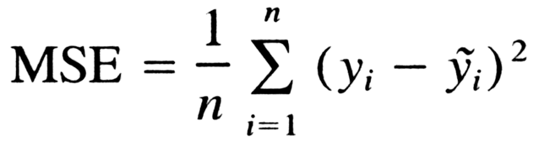
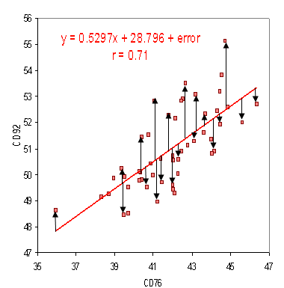
Calculating Errors – Real Valued Outputs
Input Layer
Hidden Layer
Output Layer
X
X
_{8.7}
X
₋₁₀

Slide 18
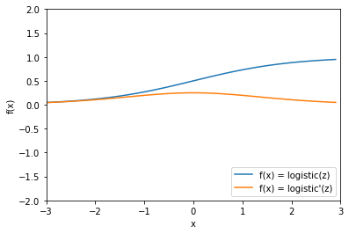
Problem
Our definition of the backprop equations is dependent on the derivative of z which is given by
a(1 - a)
If we are using a sigmoid unit (classification) then the derivative is not very strong if we are very right or very wrong!

Slide 19
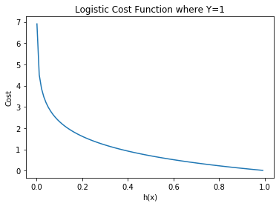
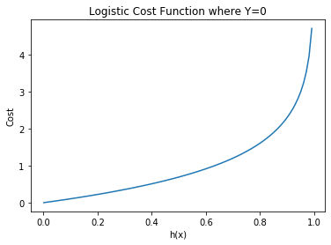
Cross Entropy Loss

Slide 20

Calculating Errors – Binary Outputs
Input Layer
Hidden Layer
Output Layer
Loss Function – Cross Entropy Loss Function
Error Derivative (final Layer)
X
X
₀
X

Slide 21
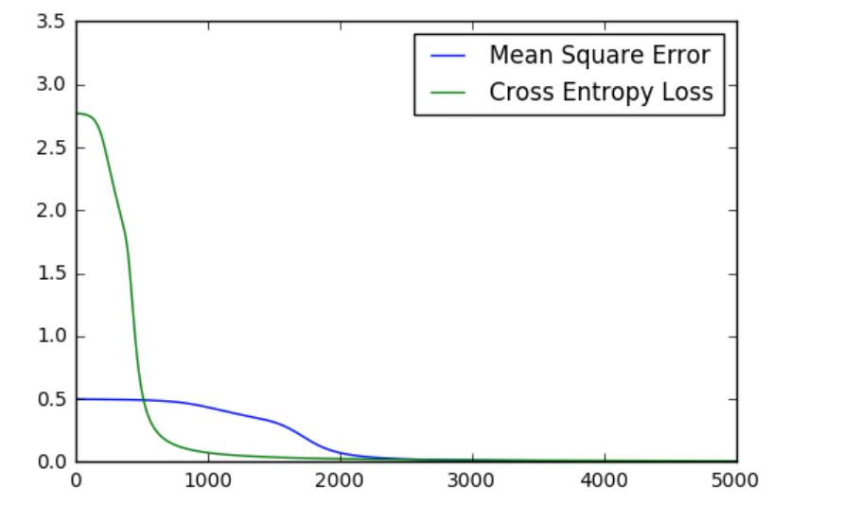
Cross Entropy Loss Function Performance

Slide 22
Calculating Errors – Multi-Label Outputs
Input Layer
Hidden Layer
Output Layer
Loss Function – Cross Entropy Loss Function
Error Derivative (final Layer)
X
₁
X
₀
X
₀

Slide 23
Calculating Errors – Multinomial Outputs
Input Layer
Hidden Layer
Output Layer
Remember / Assumption – One positive outcome per instance. Everything else negative, e.g., figure out the type of animal in an image.
Loss Function – Cross Entropy Loss Function
We can use this but it isn’t great.
X
_{0.8}
X
_{0.2}
X
_{0.1}

Slide 24

Multinomial: Softmax Activation Function
Input Layer
Hidden Layer
Output Layer
If we know that we only have one possible ‘activation’ in a given layer, we can use a
‘Softmax Activation Layer’
To take advantage of this fact.
X
Y₀
X
Y₁
X
Y₂

Slide 25
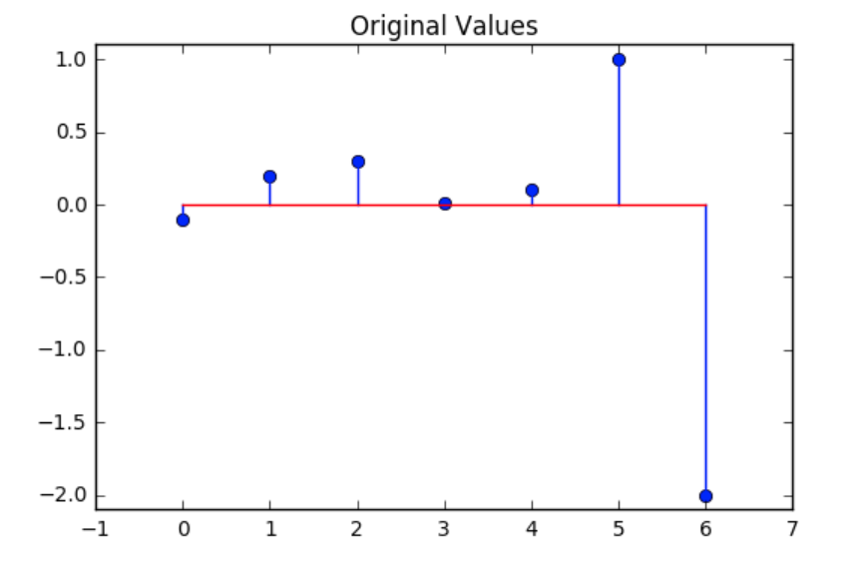
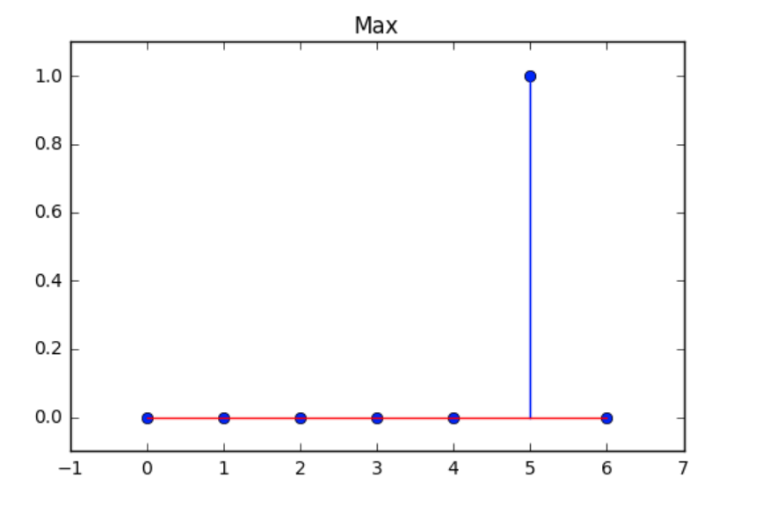
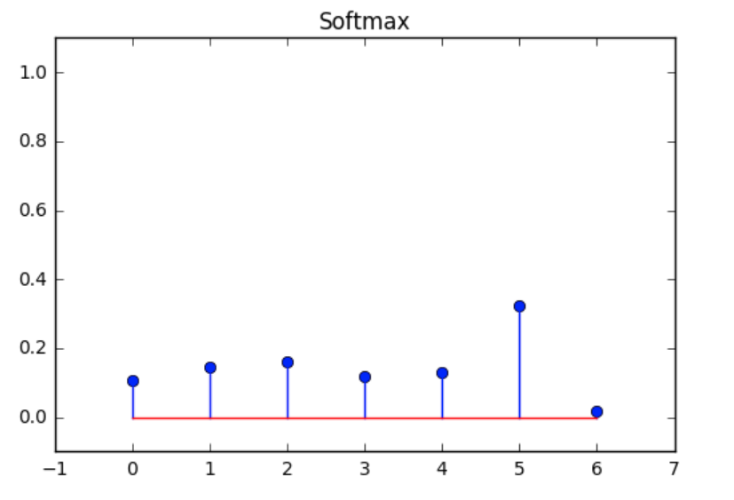

Softmax Activation Function

Slide 26
Tutorial Session Work: Loss Functions
Split into smaller groups.
As a group assign each person a loss function to investigate (look at Keras losses as a starting point) (10 mins)
Individually investigate your loss in a Keras context (10 mins)
Report back to the smaller group
Have a group reporter enter details on the losses investigated into the form provided.

